Slide 1

Sets
Sets
Notes:
Sequences

Slide 2
Definitions
A set is an unordered collection of elements, without duplicates that typically supports efficient membership tests.
  Elements of a set are like keys of a map, but without any auxiliary values.
A multiset (also known as a bag) is a set-like container that allows duplicates.
A multimap is similar to a traditional map, in that it associates values with keys; however, in a multimap the same key can be mapped to multiple values.
  For example, the index of a book maps a given term to one or more locations at which the term occurs.
Sets

Slide 3
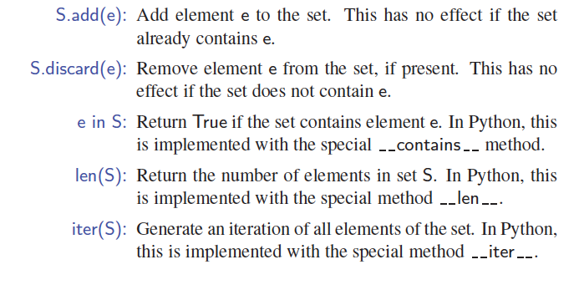
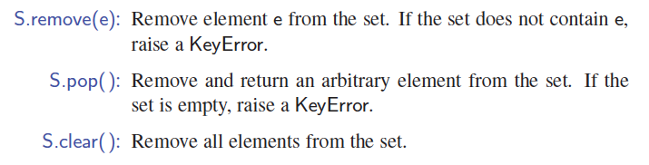
Set ADT
Sets

Slide 4
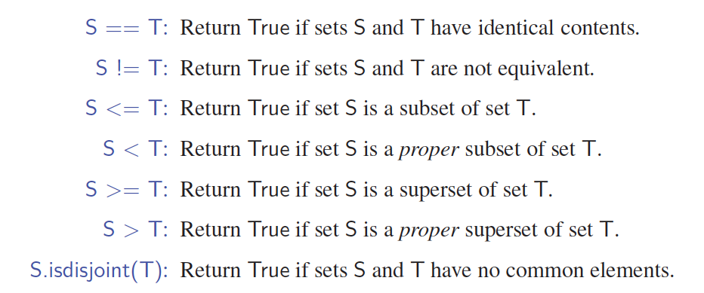
Boolean Set Operations
Sets

Slide 5
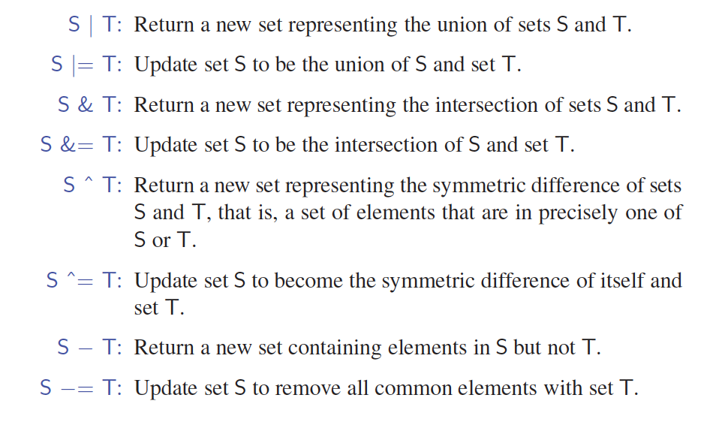
Set Update Operations
Sets

Slide 6




Storing a Set in a List
We can implement a set with a list
Elements are stored sorted according to some canonical ordering
The space used is O(n)
Nodes storing set elements in order
List
∅
Set elements
Sets

Slide 7
Generic Merging
Generalized merge of two sorted lists A and B
Template method genericMerge
Auxiliary methods
  aIsLess
  bIsLess
  bothAreEqual
Runs in O(n_{A} + n_{B}) time provided the auxiliary methods run in O(1) time
Algorithm genericMerge(A, B)
S ← empty sequence
  while ¬A.isEmpty() ∧ ¬B.isEmpty()
  a ← A.first().element(); b ← B.first().element()
  if a < b
  aIsLess(a, S); A.remove(A.first())
  else if b < a
  bIsLess(b, S); B.remove(B.first())
  else { b = a }
  bothAreEqual(a, b, S)
  A.remove(A.first()); B.remove(B.first())
  while ¬A.isEmpty()
  aIsLess(a, S); A.remove(A.first())
  while ¬B.isEmpty()
  bIsLess(b, S); B.remove(B.first())
  return S
Sets

Slide 8

Using Generic Merge for Set Operations
Any of the set operations can be implemented using a generic merge
For example:
  For intersection: only copy elements that are duplicated in both list
  For union: copy every element from both lists except for the duplicates
All methods run in linear time
Sets

